Slide 1

Module 3: Introduction to Machine Learning

Slide 2
Supervised Learning
Supervised algorithms use labelled dataset.
There is a supervisor or teacher component in supervised learning.
A supervisor provides labelled data so that the model is constructed and generates test data.
In supervised learning algorithms, learning takes place in two stages.
  First stage, the teacher communicates the information to the student that the student is supposed to master. The student receives the information and understands it. During this stage, the teacher has no knowledge of whether the information is grasped by the student.
  In Second stage of learning, the teacher asks the student a set of questions to find out how much information has been grasped by the student. Based on these questions, the student is tested, and the teacher informs the student about his assessment. This kind of learning is typically called supervised learning.

Slide 3
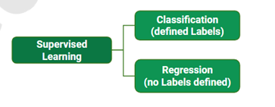
Supervised learning has two methods:
Classification : an algorithm that uses a labeled dataset to learn how to assign new, unseen data points to one of several predefined categories or classes. The output variable in classification is a categorical value
Classification is a supervised learning method.
The input attributes of the classification algorithms are called independent variables.
The target attribute is called label or dependent variable.
The relationship between the input and target variable is represented in the form of a structure which is called a classification model.

Slide 4
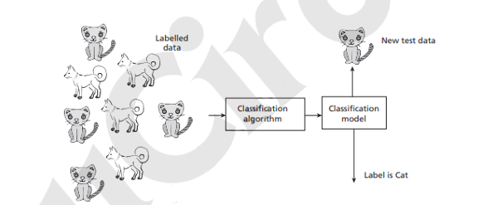
Classification :
An example were figure shows a classification algorithm takes a set of labelled data images such as dogs and cats to construct a model that can later be used to classify an unknown test image data.
In classification, learning takes place in two stages.
During the first stage, called training stage, the learning algorithm takes a labelled dataset and starts learning. After the training set, samples are processed and the model is generated.
In the second stage, the constructed model is tested with test or unknown sample and assigned a label. This is the classification process.
Some of the key algorithms of classification are Decision Tree, Random Forest, Support Vector Machines, Naïve Bayes, Artificial Neural Network and Deep Learning networks like CNN.

Slide 5
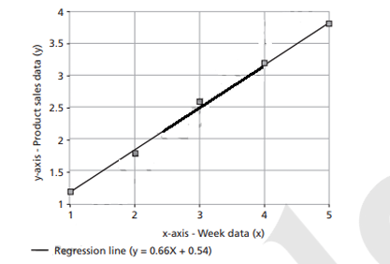
Regression Models
A technique used to predict continuous numerical values (e.g., house prices, temperature, salary) by learning the relationship between input features (independent variables) and a target variable (dependent variable) from labeled training data.
A fitted regression model is shown in Figure for a dataset that represent weeks input x and product sales y.
The regression model takes input x and generates a model in the form of a fitted line of the form y = f(x).
Here, x is the independent variable that may be one or more attributes and y is the dependent variable.
The advantage of this model is that prediction for product sales (y) can be made for unknown week data (x).

Slide 6
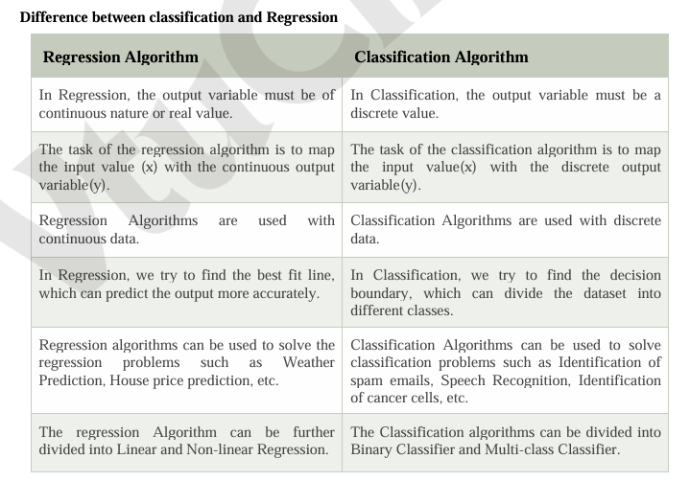

Slide 7
Unsupervised Learning
The second kind of learning is by self-instruction. As the name suggests, there are no supervisor or teacher components.
This process of self-instruction is based on the concept of trial and error. Here, the program is supplied with objects, but no labels are defined.
The algorithm itself observes the examples and recognizes patterns based on the principles of grouping. Grouping is done in ways that similar objects form the same group.
Cluster analysis and Dimensional reduction algorithms are examples of unsupervised algorithms.

Slide 8
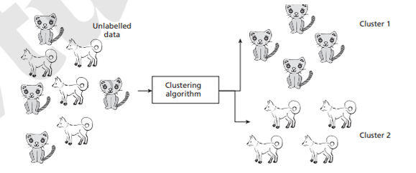
Cluster Analysis
Cluster analysis aims to group objects into disjoint clusters or groups.
Cluster analysis clusters objects based on its attributes.
All the data objects of the partitions are similar in some aspect and vary from the data objects in the other partitions significantly.
Example: The clustering algorithm takes a set of dogs and cats images and groups it as two clusters-dogs and cats. It can be observed that the samples belonging to a cluster are similar and samples are different radically across clusters.

Slide 9
Dimensionality Reduction
Dimensionality reduction algorithms are examples of unsupervised algorithms.
It takes a higher dimension data as input and outputs the data in lower dimension by taking advantage of the variance of the data.
It is a task of reducing the dataset with few features without losing the generality.

Slide 10
Semi-supervised Learning
There are circumstances where the dataset has a huge collection of unlabelled data and some labelled data.
Labelling is a costly process and difficult to perform by the humans.
Semi-supervised algorithms use unlabelled data by assigning a pseudo-label.
Then, the labelled and pseudo-labelled dataset can be combined.

Slide 11
Reinforcement Learning
Reinforcement learning mimics human beings.
Like human beings use ears and eyes to perceive the world and take actions, reinforcement learning allows the agent to interact with the environment to get rewards.
The agent can be human, animal, robot, or any independent program.
The rewards enable the agent to gain experience.
The agent aims to maximize the reward.
The reward can be positive or negative (Punishment).
When the rewards are more, the behavior gets reinforced and learning becomes possible.

Slide 12
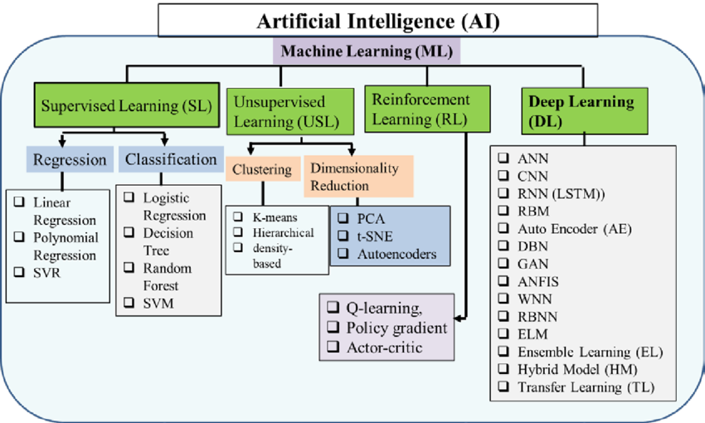

Slide 13
Difference between Supervised and unsupervised Learning

Slide 14
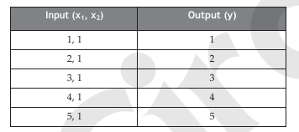
CHALLENGES OF MACHINE LEARNING
Computers are better than humans in performing tasks like computation. For example, while calculating the square root of large numbers, an average human may blink but computers can display the result in seconds.
Still, there are tasks where humans are better as machine learning systems still require quality data for model construction. The quality of a learning system depends on the quality of data. This is a challenge.
Problems – Machine learning can deal with the ‗well-posed‘ problems where specifications are complete and available. Computers cannot solve ‗ill-posed‘ problems.
Consider one simple example:

Slide 15
2. Huge data – This is a primary requirement of machine learning. Availability of a quality data is a challenge. A quality data means it should be large and should not have data problems such as missing data or incorrect data.
3. High computation power – With the availability of Big Data, the computational resource requirement has also increased. Systems with Graphics Processing Unit (GPU) or even Tensor Processing Unit (TPU) are required to execute machine learning algorithms. Also, machine learning tasks have become complex and hence time complexity has increased, and that can be solved only with high computing power.
4. Complexity of the algorithms – The selection of algorithms, describing the algorithms, application of algorithms to solve machine learning task, and comparison of algorithms have become necessary for machine learning or data scientists now.
5. Bias/Variance – Variance is the error of the model. This leads to a problem called bias/ variance tradeoff. A model that fits the training data correctly but fails for test data, in general lacks generalization, is called overfitting. The reverse problem is called underfitting where the model fails for training data but has good generalization.

Slide 16
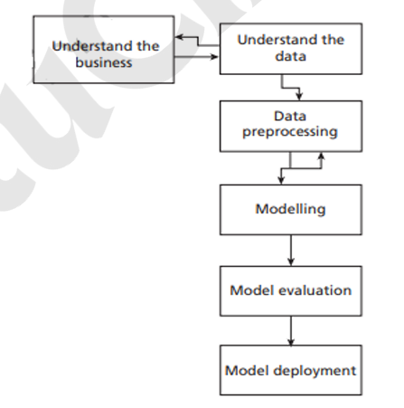
MACHINE LEARNING PROCESS

Slide 17
1. Understanding the business – This step involves understanding the objectives and requirements of the business organization. Generally, a single data mining algorithm is enough for giving the solution. This step also involves the formulation of the problem statement for the data mining process.
2. Understanding the data – It involves the steps like data collection, study of the characteristics of the data, formulation of hypothesis, and matching of patterns to the selected hypothesis.
3. Preparation of data – This step involves producing the final dataset by cleaning the raw data and preparation of data for the data mining process. The missing values may cause problems during both training and testing phases. Missing data forces classifiers to produce inaccurate results.
4. Modelling – This step plays a role in the application of data mining algorithm for the data to obtain a model or pattern.

Slide 18
5. Evaluate – This step involves the evaluation of the data mining results using statistical analysis and
visualization methods. The performance of the classifier is determined by evaluating the accuracy
of the classifier. The process of classification is a fuzzy issue.
6. Deployment – This step involves the deployment of results of the data mining algorithm to
improve the existing process or for a new situation.

Slide 19
MACHINE LEARNING APPLICATIONS
1. Sentiment analysis – This is an application of natural language processing (NLP) where the words of documents are converted to sentiments like happy, sad, and angry which are captured by emoticons effectively. For movie reviews or product reviews, five stars or one star are automatically attached using sentiment analysis programs.
2. Recommendation systems – These are systems that make personalized purchases possible. For example, Amazon recommends users to find related books or books bought by people who have the same taste like you, and Netflix suggests shows or related movies of your taste. The recommendation systems are based on machine learning.
3. Voice assistants – Products like Amazon Alexa, Microsoft Cortana, Apple Siri, and Google Assistant are all examples of voice assistants. They take speech commands and perform tasks. These chatbots are the result of machine learning technologies.
4. Technologies like Google Maps and those used by Uber are all examples of machine learning which offer to locate and navigate shortest paths to reduce time.

